Slide 1
AUTHENTICATION AND AUTHORIZATION WITH JWT
SAIOM PAL

Slide 2
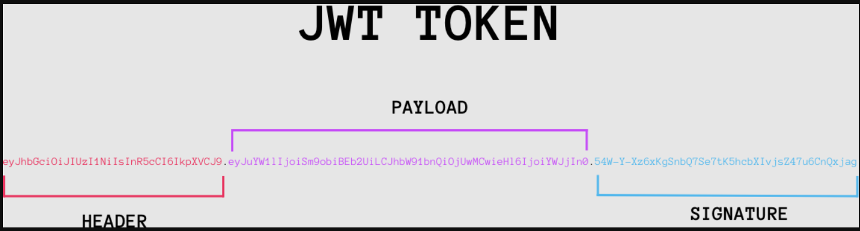
JWT (JSON WEB TOKENS)
JSON Web Token is a proposed Internet standard for creating data with optional signature and/or optional encryption whose payload holds JSON that asserts some number of claims. The tokens are signed either using a private secret or a public/private key.

Slide 3
PROCESS BREAKDOWN
A user is usually authenticated by entering a username, email address, and/or password and then being given access to various resources or services. By its very existence, authentication relies on maintaining the user’s state.
The Angular app can then send the token to the backend as an Authorization header to show they’re authenticated. The JWT should be checked by the backend, and access should be granted based on its validity.

Slide 4
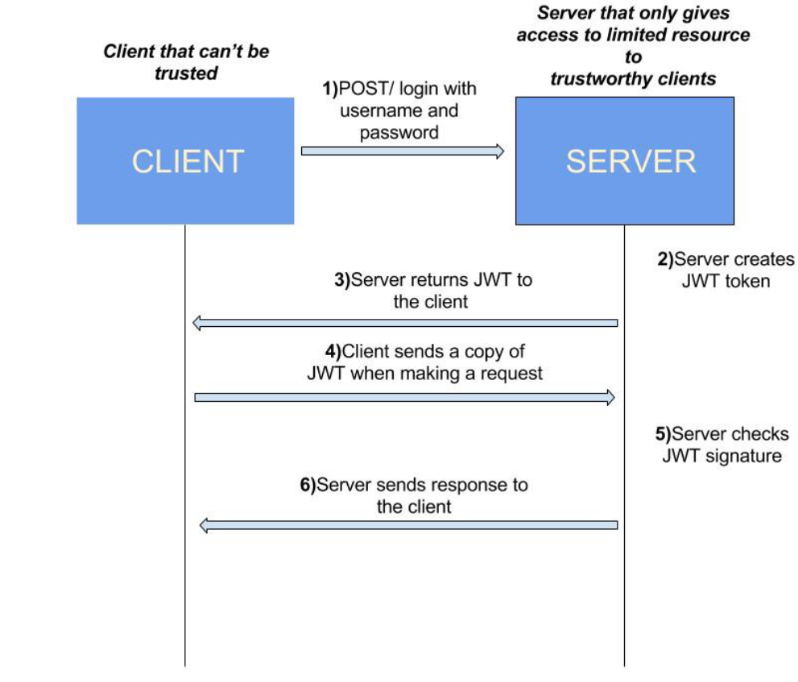

Slide 5
STEPS INVOLVED
Login and User components:
This includes creating the frontend forms and services that post the request to the endpoints
2. Creating JWT based user session:
Creating a JWT Session Token using node-jsonwebtoken
3. Sending JWT back to the client
4. Storing and using the JWT on the client side

Slide 6
5. Sending the JWT back to the server on each request:
This includes building an authentication HTTP interceptor.
6. Validating user requests:
Building a custom Express middleware for JWT validation

Slide 7
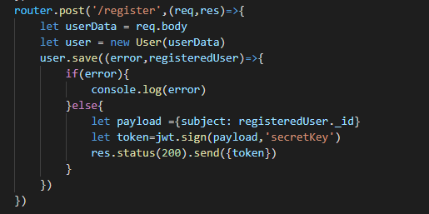
Token Creation Example

Slide 8
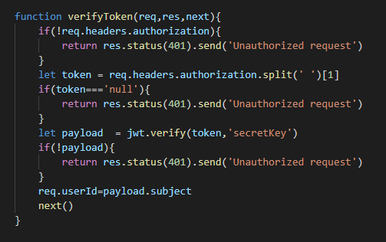
Token Verification Method

Slide 9
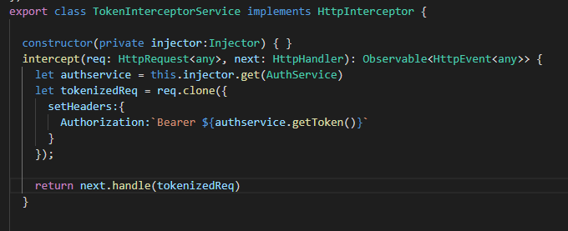
Token Interception in Front-end

Slide 10
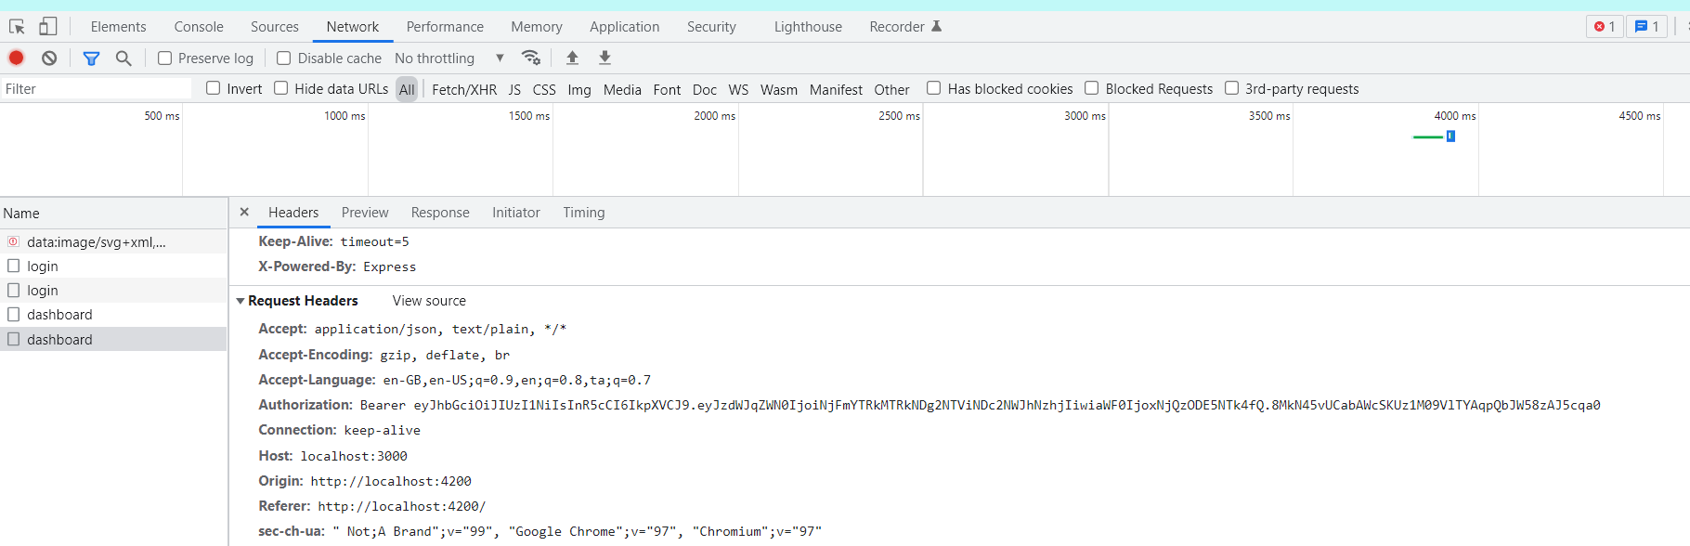
Inspecting the network tab for added authorization on login

Slide 11
THE END

